Slide 1




DATA MANAGEMENT SYSTEMS
BY: SUMITHRA
ANUREET
KHUSHI
KAWAL
Vanshnoor

Slide 2


Agenda
To analyze rental listing data from Kijiji and RentFaster and assess nearby restaurant quality using Yelp API.
STEPS INCLUDES
1
Data Collection
2
Data Management
3
Data Analysis

Slide 3


Data Collection
Collected diverse and comprehensive rental listing data for detailed analysis using Kijiji and RentFaster.
Information gathered contains price, address, number of bedrooms, features, and additional pertinent property information.
The key actions involve setting up a Spark Cluster to efficiently manage and process data, and creating DataFrames to use Spark SQL for analysis.
Challenges included managing large datasets, optimizing data processing, and integrating data from various sources with Yelp API data.
The Yelp API was integrated to enhance rental listings, incorporating nearby restaurants and amenities, and enhancing the dataset with geographical and qualitative metrics.
Four thorough CSV files with overview and detailed data were created, two for each platform, in preparation for the upcoming stages.

Slide 4



Data Analysis
The goal is to gain actionable insights from a comprehensive data analysis using Apache Spark SQL for data querying and manipulation.
The key actions involved conducting exploratory and correlation analyses to comprehend trends and relationships, addressing complex data relationships and addressing additional quality issues.
Gained insights into key factors influencing rental prices and local amenities' impact, and created visual representations using Spark's tools for clearer dissemination.
The analysis provided a comprehensive understanding of the rental market dynamics and the various amenity impacts in Alberta.

Slide 5
Cities Selected
1
Edmonton
2
Red-deer
3
Fort mucmurry
4
Spruce grove
5
St Albert
6
Beaumont

Slide 6
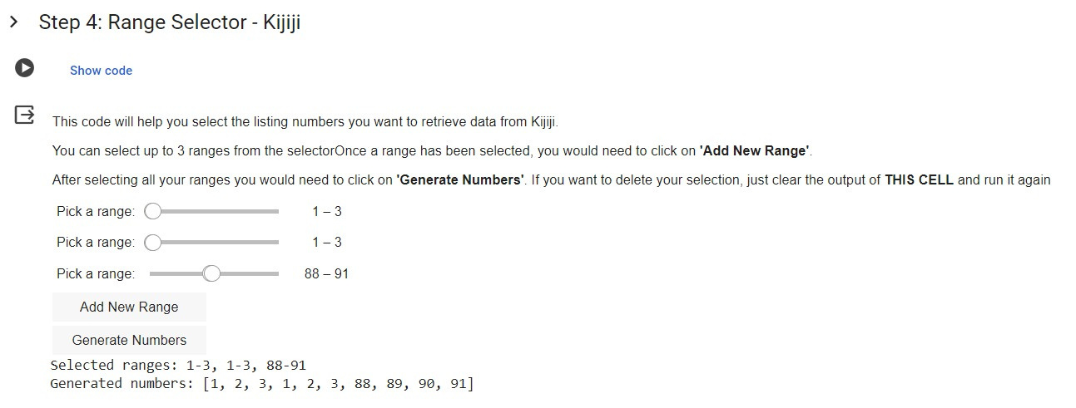
Range Selector - Kijiji
The screenshot shows a tool for selecting ranges of listings from Kijiji for data retrieval, allowing users to select up to three ranges and generate numbers for specific listings.

Slide 7

Data Volume
750
RENTFASTER
430
KIJIJI
200
YELP

Slide 8

Data Management
The data was efficiently organized and prepared for insightful analysis using Apache Spark for robust data processing and management.
The process involved establishing a Spark Cluster for distributed data handling and creating Spark DataFrames from CSV files for improved data manipulation.
Challenges included managing large datasets for scalability and integrating diverse data sources, including the Yelp API.
The enhancements include enhancing rental listings with Yelp's geographic and quality data, and standardizing and cleaning Spark data for improved analysis quality.
The dataset is structured for deep analytical processing, and the next steps involve exploring the data, applying Spark SQL, and utilizing visualization for insights.

Slide 9

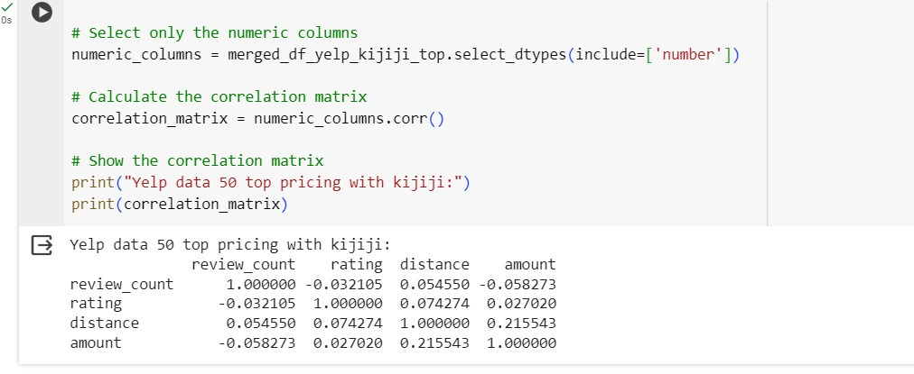
Yelp data 50 top pricing with Kijiji
The screenshot shows a correlation matrix from a merged DataFrame, indicating a no correlation between the amount of a listing and review_count,

Slide 10
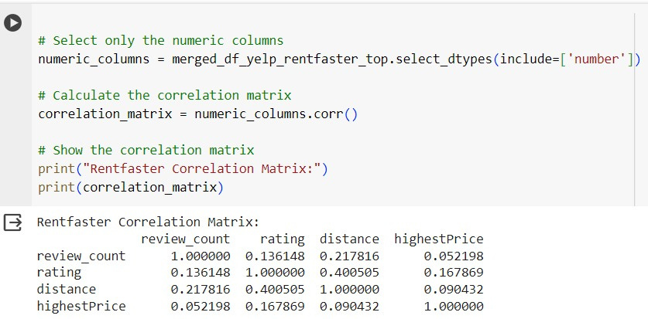
Rentfaster Correlation Matrix
The image shows a correlation matrix combining Yelp and RentFaster data, showing a no correlation between distance and highest price.

Slide 11


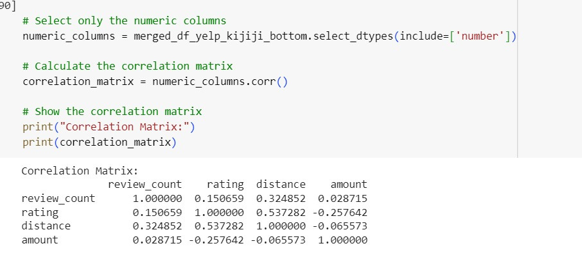
Correlation Matrix
The correlation matrix for Yelp and Kijiji bottom 50 listings shows a no strong correlation between distance and rating.

Slide 12


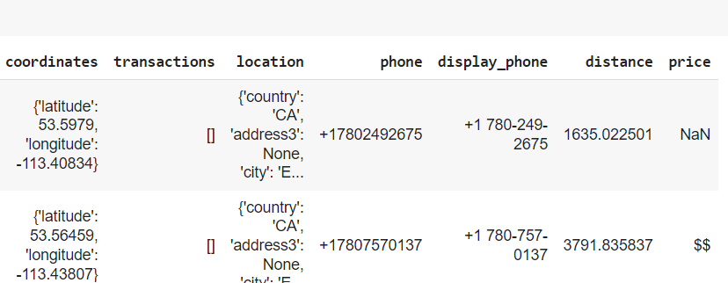


Problem with YELP
There is no value presented in the price column from Yelp API

Slide 13
Datapipelines
Data Collection from Kijiji and Rentfaster Website:
Save the data as a CSV files
Data Loading and Processing in Spark:
Data Collection from Yelp:
Data Analysis in pandas
Yes, this Datapipelines helped with large dataset

Slide 14
Next Steps
Enhance the datasets' quality through the acquisition of price values for restaurant data.
Subsequently, we plan to conduct correlation analysis based on this enriched dataset.

Slide 15

Thank you!

